Slide 1
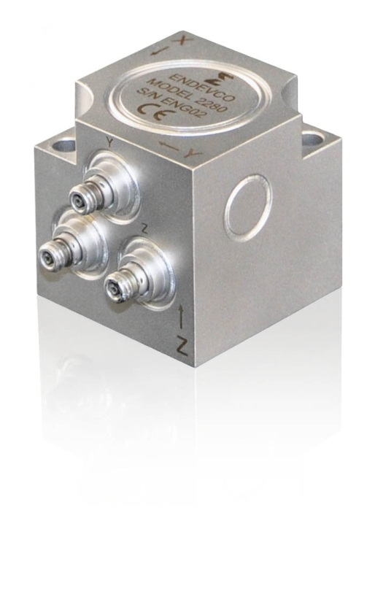
Model 2280 key features Triaxial PE accelerometer
+900˚F (+482˚C) operation
3.0 pC/g typical, 2.4 pC/g minimum
Signal return isolated from case
Bolt mount (2 x 8-32 screws)
Three 10-32 side connectors
1.35 inch (34.29 mm) square
0.55 pounds (250 grams)
CE marked
Enhances the Endevco portfolio of extreme high temperature accelerometer products
Notes:
1

