Slide 1
New product introduction
883M digital triaxial accelerometer and temperature sensor

Slide 2

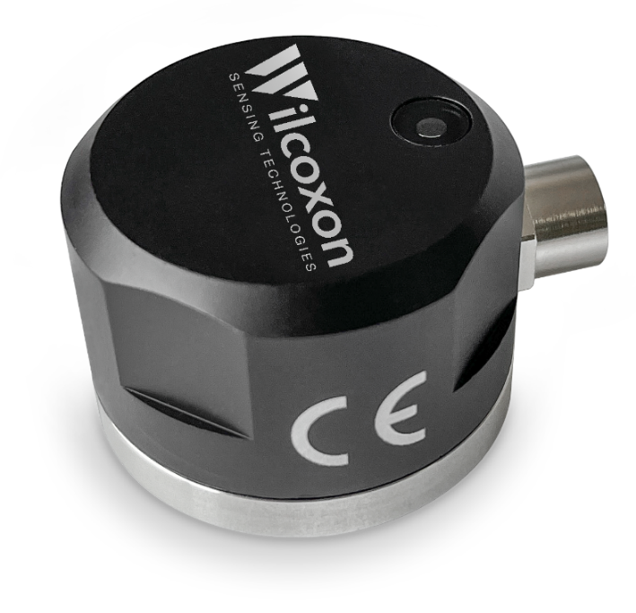
883M product overview
Triaxial MEMS accelerometer and temperature sensor
Up to 5kHz high-frequency response
IP67 design, operates in harsh environments with excellent durability and reliability
Modbus RTU communication protocol over an RS-485 serial bus ensures stable data transmission
Digital output of vibration spectrum, time waveforms, and 12 frequency bands, facilitating machine fault diagnosis
Frequency bands align with international standards for machine vibration measurement
  ISO 10816-3 and ISO 20816-3 standards for mechanical vibrations
  ISO 17243 machine tool spindle vibrations
Condition monitoring applications: balance-of-plant, process monitoring, energy, automated equipment, semiconductor manufacturing

Slide 3


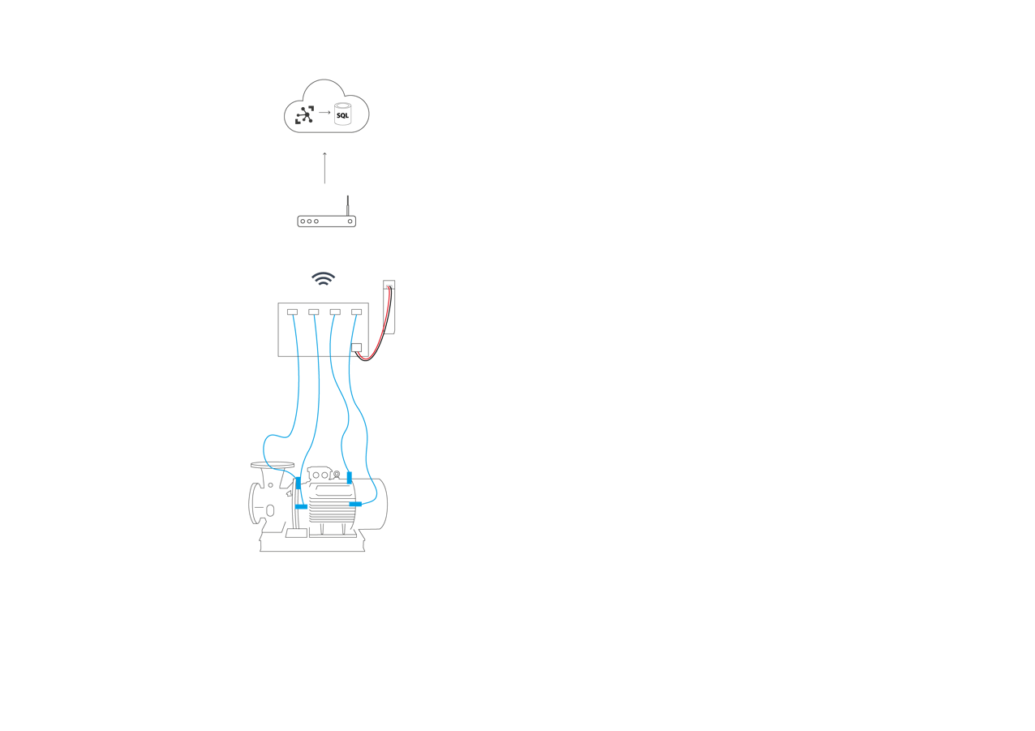

Deployment architecture
Connected via SCADA system
SCADA system
Programmable logic controller, power
Modbus RS-485 trunk line
RM8-J94-ST-50 cables
883M accelerometers

Slide 4



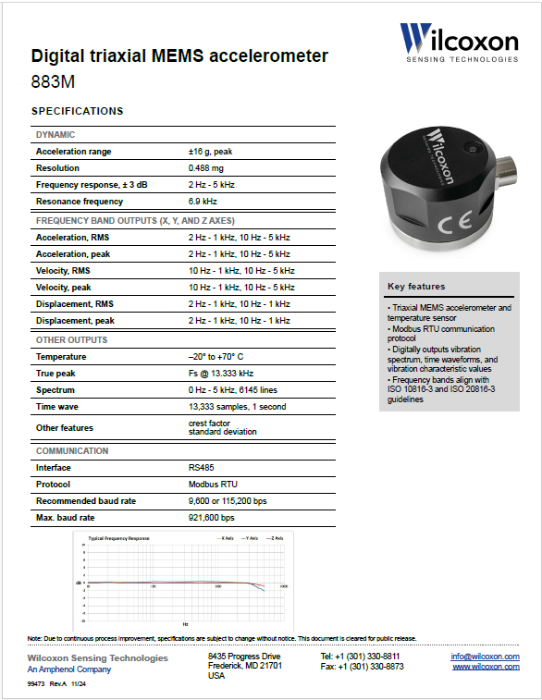
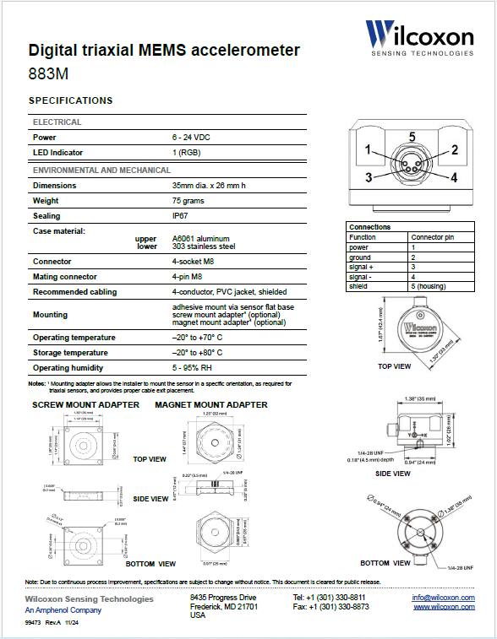
Specifications
Click to download

Slide 5
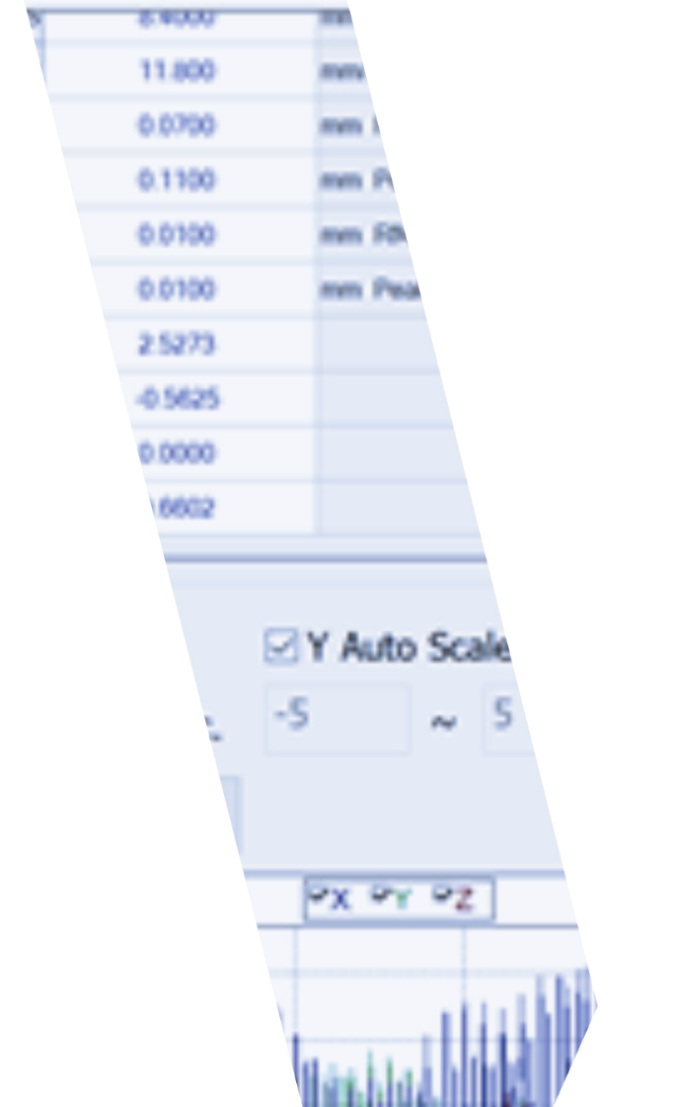
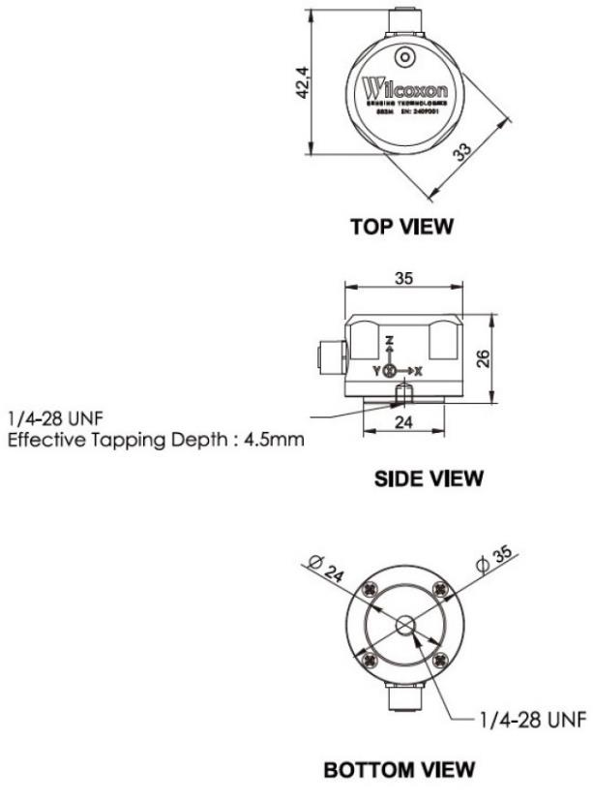
Key specifications
DYNAMIC |  | ENVIRONMENTAL & MECHANICAL
Acceleration range | ±16 g, peak | IP Rating | IP67
Resolution | 0.488 mg | Operating temperature | -20 to +70 °C
Frequency range | 2 Hz – 5 kHz (± 3 dB) | Storage Temperature | -20 to +80 °C
 |  | Connector | M8 4-socket female
COMMUNICATION
Interface | RS485
Protocol | Modbus RTU
Max. baud rate | 921,600 bps
Recommended baud rate | 9,600 or 115,200 bps

Slide 6
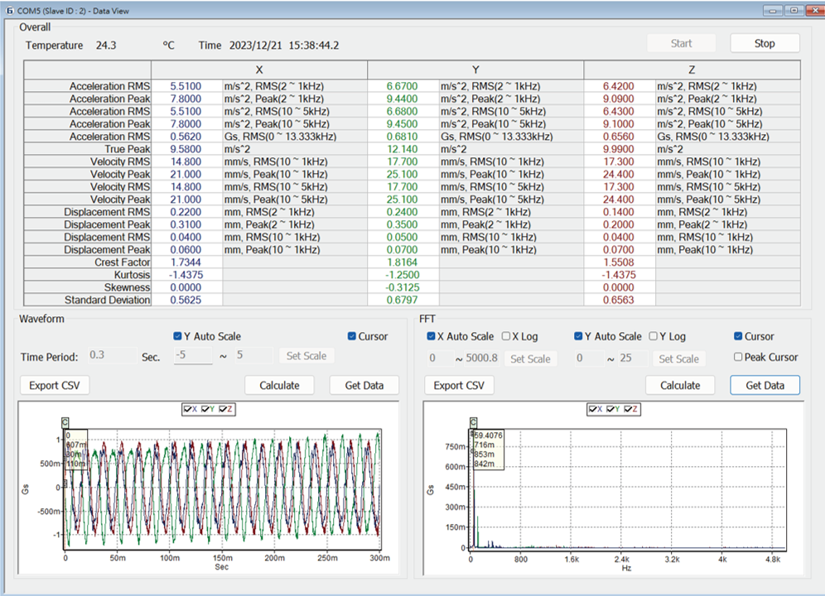
883M digital sensor
Output and programmed frequency bands
Frequency bands (X, Y, and Z axes)
Acceleration, RMS 2 Hz - 1 kHz, 10 Hz - 5 kHz
Acceleration, peak 2 Hz - 1 kHz, 10 Hz - 5 kHz
Velocity, RMS 10 Hz - 1 kHz, 10 Hz - 5 kHz
  Velocity RMS 10 Hz - 1 kHz frequency band aligns with ISO 10816-3 and 20816-3 guidelines
Velocity, peak 10 Hz - 1 kHz, 10 Hz - 5 kHz
Displacement, RMS 2 Hz - 1 kHz, 10 Hz - 1 kHz
  Displacement RMS 2 Hz - 1 kHz and 10 Hz - 1 kHz frequency bands align with ISO 20816-3 guidelines
Displacement, peak 2 Hz - 1 kHz, 10 Hz - 1 kHz
Other outputs
Temperature sensor –20° to +70° C
True peak Fs @ 13.333 kHz
Spectrum 0 Hz - 5 kHz, 6145 lines
Time waveform 13,333 samples, 13.333 kHz Fs
Other features crest factor, standard deviation

Slide 7
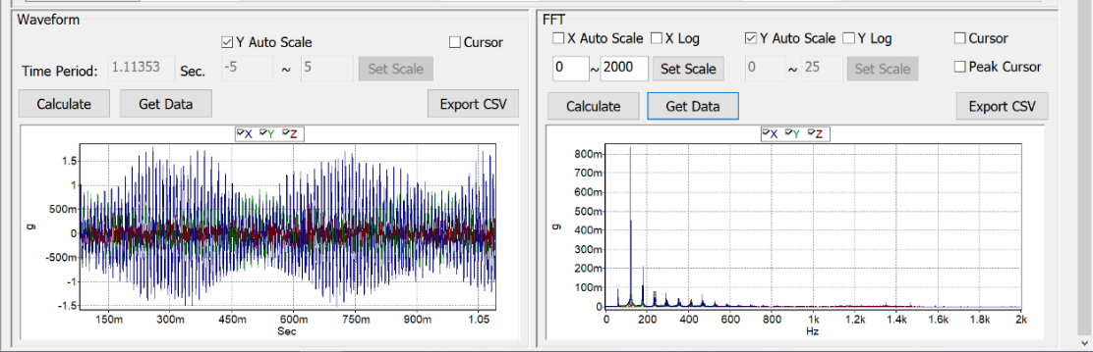
Key features
Measurements
Synchronous measurement of machine vibrations in three axes and temperature
Detection of overall of vibration acceleration, velocity, and displacement
Extraction of time-domain waveforms and calculation of FFT spectra
True-peak detection for real-time bearing condition monitoring
Built-in self testing with real-time LED status indicator

Slide 8
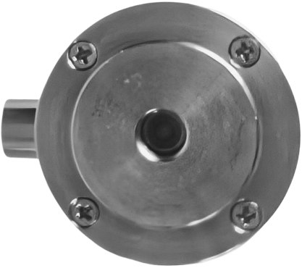
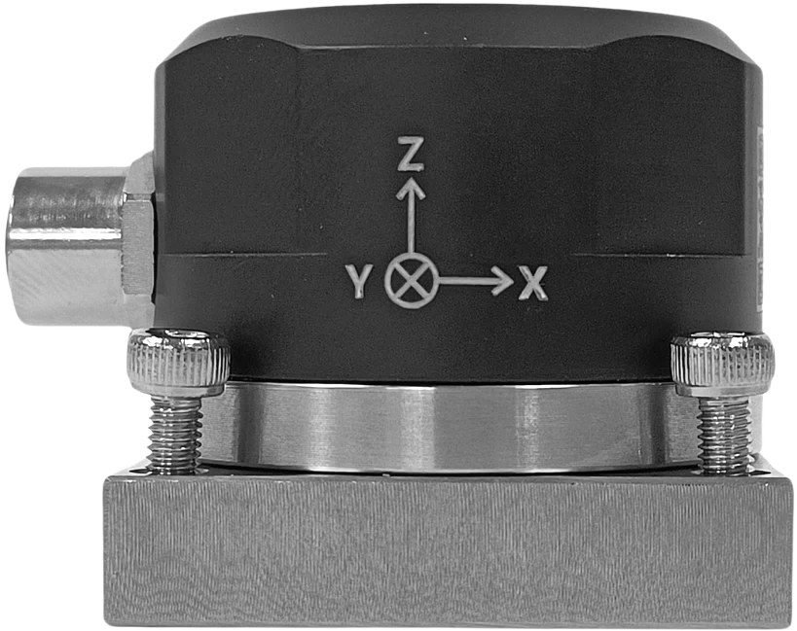
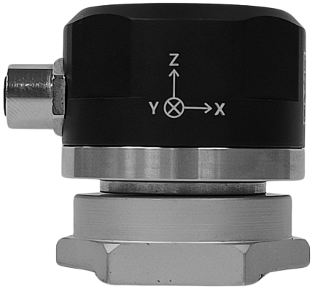
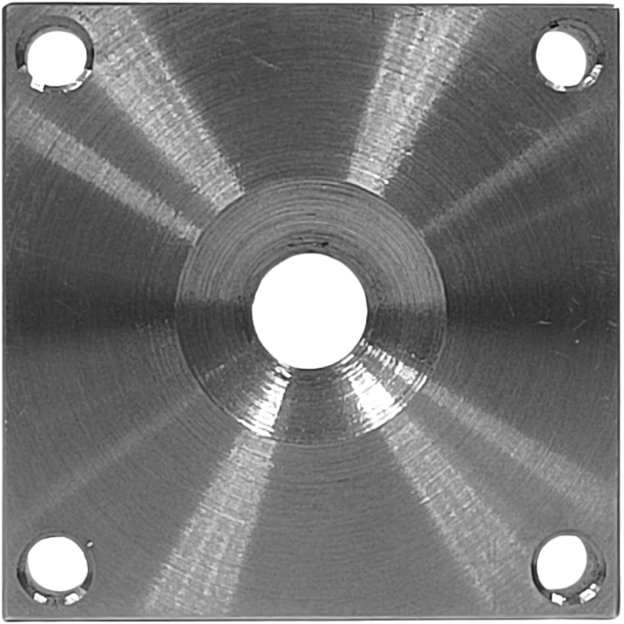
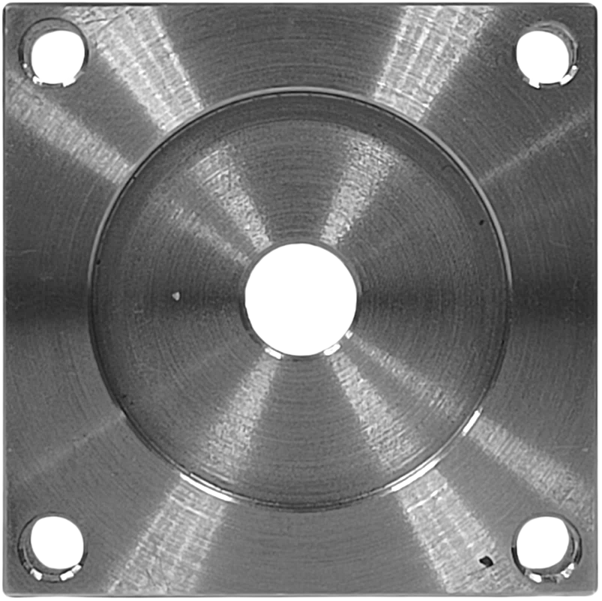
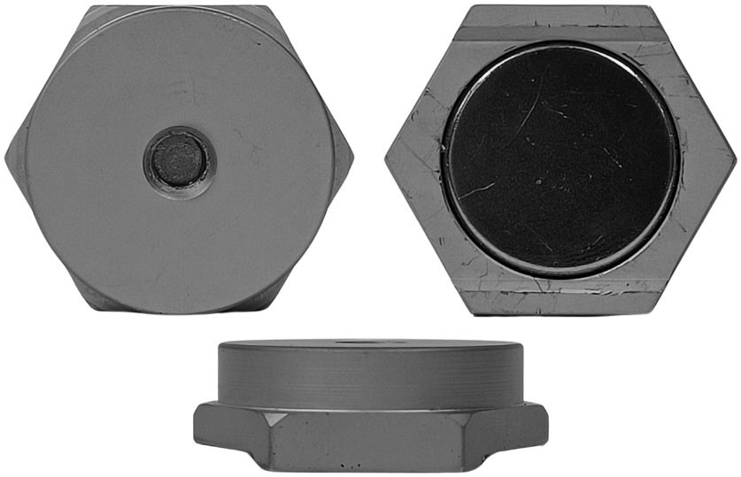
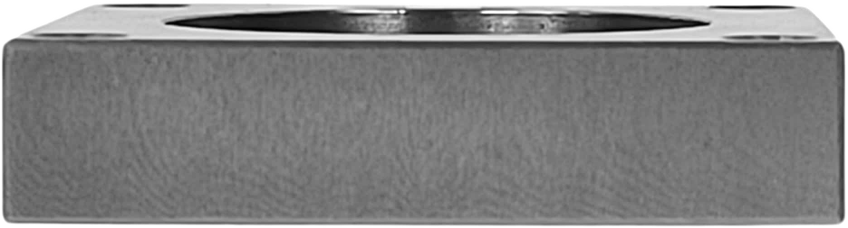
Mounting options
Adhesive, screw, or magnet mounting
Adhesive mount
883M*
Screw mount
883M-SMA
Magnet mount
883M-MMA
*No mounting adapter or adhesive included. The sensor’s flat bottom surface can be used to adhere the sensor to the structure.

Slide 9
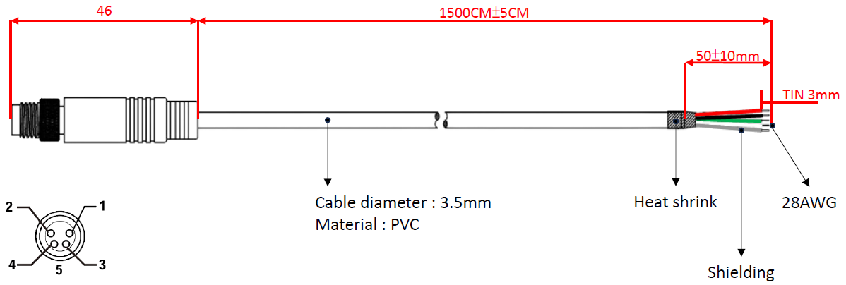
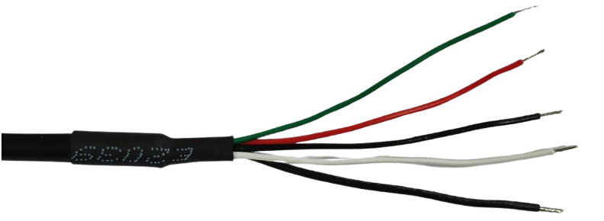
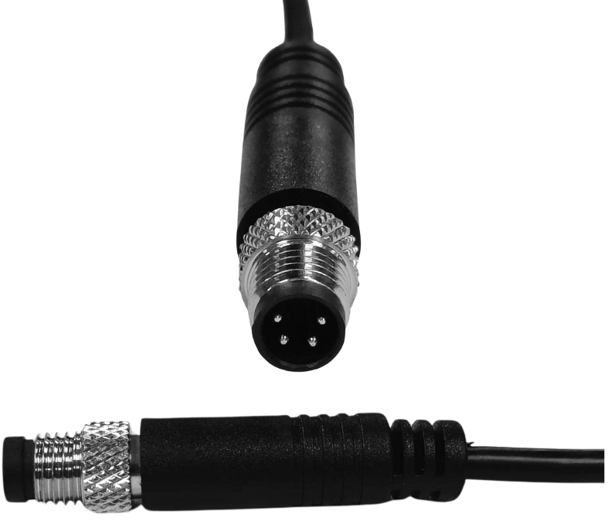
Compatible cable, included
RM8-ST-J94-50
M8 4-pin (male) sensor connector, brass, -20 to +80 ºC, IP67
4-conductor UL 2725 cable with black, PVC jacket, foil shielded, 28 AWG (3.5 mm diameter), -10 to +80 ºC
Stripped and tinned, heat shrink
50 ft (15 m) length standard
CE, RoHS2.0 and REACH compliant

Slide 10
Applications
Applications
Rotating machinery: motors, fans, blowers, pumps, compressors, etc.
Transmission systems: gearboxes, couplings, bearings, etc.
Manufacturing equipment: CNC machines, conveyor belts, etc.
HVAC systems: compressors, cooling towers, cranes, lifting equipment, road rollers, etc.

Slide 11

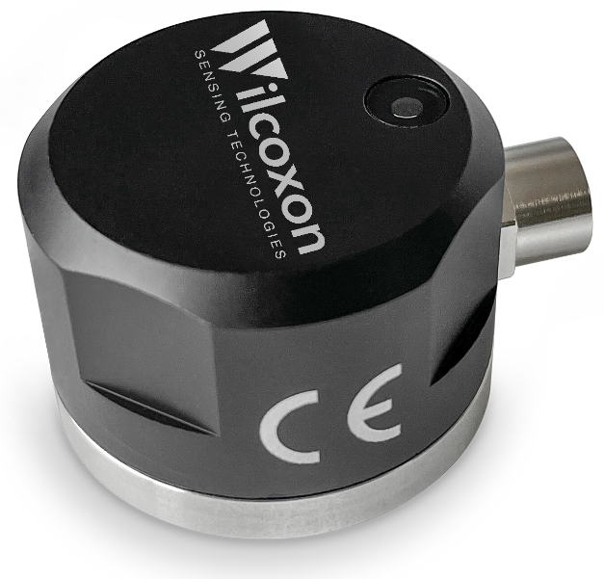
Thank you
Download the specifications
Download the user manual
Visit the product page

